Slide 1
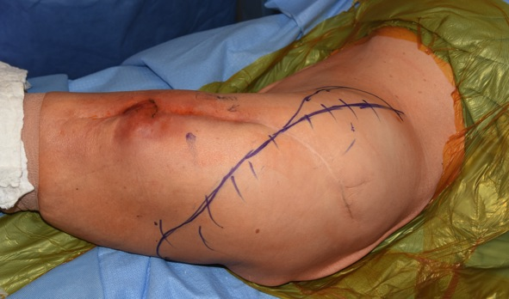
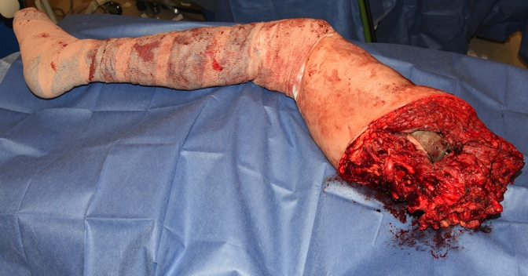
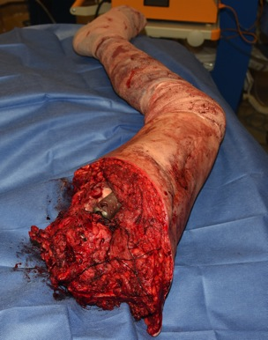
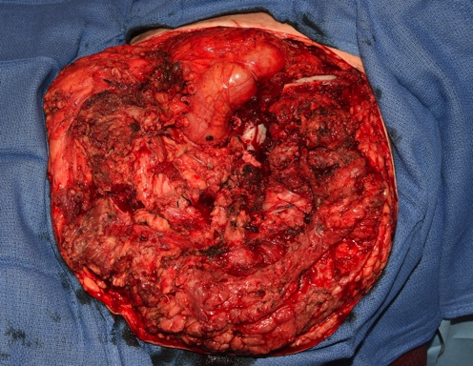
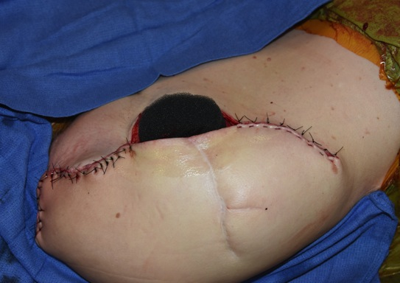
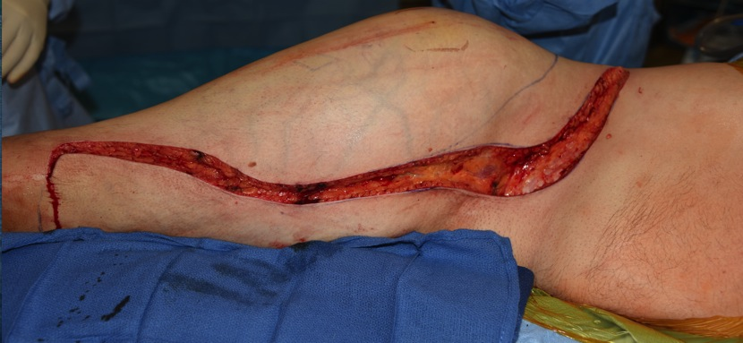
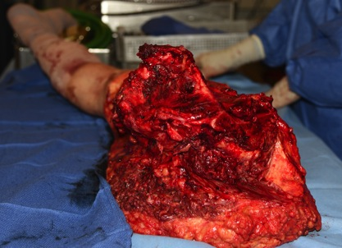
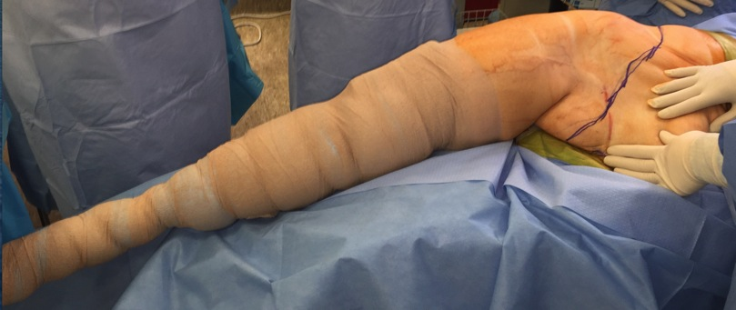
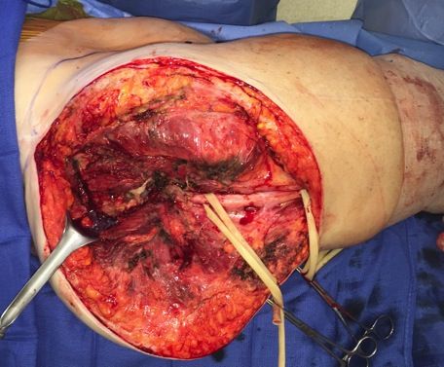
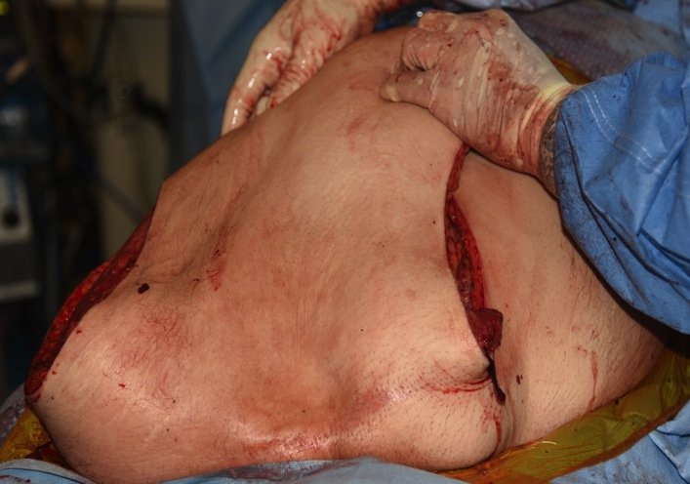
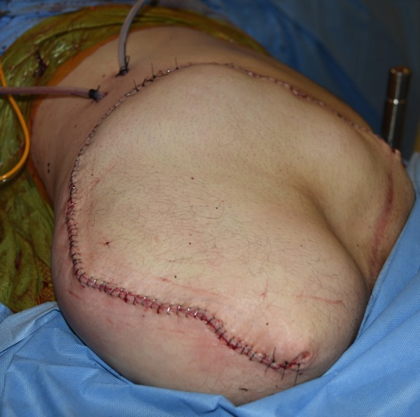
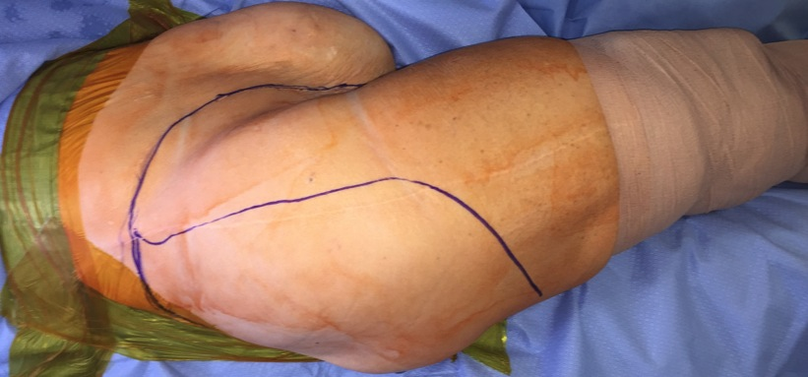
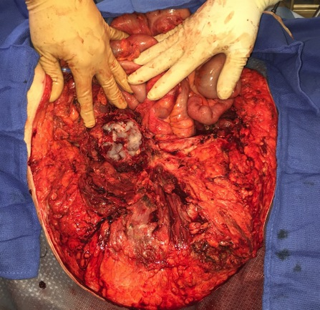
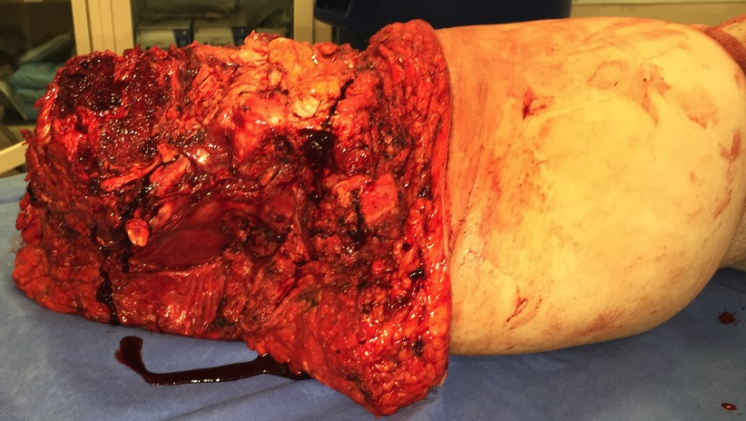
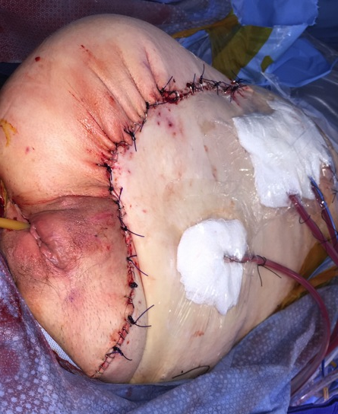
Hemipelvectomy Surgical Techniques and Outcomes
Laura Sonnylal, B.S. ¹, Tyler Hoskins, B.S. ¹, James C. Wittig, M.D. ¹
¹John Theurer Cancer Center, Hackensack University Medical Center
Background
Results
Hemipelvectomies were first introduced in 1891, but lacked successful survival rates until 1895. Since then there have been substantial modifications to the surgical technique. Common indications for patients undergoing a hemipelvectomy include malignant or locally aggressive tumors such as osteosarcoma, chondrosarcoma, and Ewing’s sarcoma. Some rare cases include trauma, prosthetic infection, and osteomyelitis. Aggressive tumors as such cause bone destruction as well as soft tissue damage to the pelvis and adjacent muscles. A curative surgical approach demands an accurate resection margin. Tumor size and location of the primary tumor are also of equal importance to the surgeon. Hemipelvectomies can be classified as traditional, modified or extended. Traditional hemipelvectomies entail amputation of the entire pelvis and lower extremity through the sacroiliac joint. An extended hemipelvectomy typically includes a portion of the sacrum. Modified hemipelvectomies are performed above the level of the acetabulum and through the pubic symphysis therefore preserving the upper portion of the iliac wing. Hemipelvectomies can be performed with a posterior flap utilizing the gluteus maximus and/or overlying skin for closing the wound or with an anterior flap that preserves the external iliac vessles and quadriceps musculature for closure. Associative morbidity, both intraoperatively and post-operatively, may be reduced via a systematic surgical approach. Prognosis largely depends on the type and extent of disease. Complications include severe bleeding, wound complications, and phantom limb pain.
Four patients underwent a right hemipelvectomy, while 2 were treated with a left hemipelvectomy. Two patients had a modified hemipelvectomy and 4 had standard hemipevectomies. Four patients underwent a posterior flap hemipelvectomy, while 2 were treated with an anterior flap. Estimated blood loss was 1 liter (3), 1.5 liters (1), 2 liters (1), and 3 liters (1). Three patients required repeat OR visits for a non-healing wound. Complications consisted of pain (2), phantom limb pain (2) with an average pain score of 4.5/10 (range of 4-5), depression and incontinence of urine (1), thrombus in the pelvic vein in conjunction with bilateral pulmonary emboli (1). Two patients are survivors at 13 and 38 months postop. Both patients are pain free and lead active lives. One patient swims in the ocean and is working part time. Both were treated for non-oncological reasons (infection). Four patients in this study are deceased. One deceased patient who had a recurrent pelvic myxofibrosarcoma one year after the index procedure underwent a right hemipelvectomy and subsequent resection of lung metastasis. This patient decided against chemotherapy and chose to continue end of life care. The second patient died from metastatic endometrial carcinoma approximately 1 year post op right hemipelvectomy. A third patient died approximately 6 months post op right hemipelvectomy from recurrent chondrosarcoma with metastatic disease. A fourth patient died 13 months post op from unknown reasons as patient was lost to follow up.
Figure 2. Modified Left Hemipelvectomy for chronically infected total hip replacement with osteomyelitis.
Surgical Indications & Technique
Indications for undergoing a hemipelvectomy include non-metastatic sarcoma that fails to respond to chemotherapy or radiation, large sarcomas involving multiple compartments of the thigh, pathological fractures that cause contamination in tissue, recurrent sarcomas of the proximal thigh or pelvic region, nononcologic conditions such as uncontrolled sepsis or osteomyelitis, recurrent total hip replacement infections, tumors involving the buttocks which cannot be resected, as well as failed attempts after limb-sparing surgery.
Posterior Flap Hemipelvectomy involves an ilioinguinal incision allowing the retroperitoneal space to be explored. The external iliac vessels are ligated and transected. A perineal incision is made extending from the symphysis pubis down to the ischium along the inferior pubic ramus. Final steps involve release of the sacroiliac joint and remaining pelvic sling muscles as well as the sacrotuberous and sacrospinous ligaments. The lumbosacral plexus is transected adjacent to the sacroiliac joint. If a posterior modified hemipelvectomy is performed the wing of the ilium is transected from the sciatic notch to midportion of the ilium.
Anterior Flap Hemipelvectomy requires anterior and posterior incisions. The anterior incision is extended along the anterior thigh so the skin can be elevated with the quadriceps off the surface of the femur. The external iliac blood and superficial femoral vessels are preserved to supply the anterior flap. The hypogastric blood vessels are ligated and transected. The superficial femoral blood vessels are tied off at the adductor hiatus. The gluteus maximus muscles are severed from the coccyx and sacrotuberous ligament. After release of the quadricep muscle and myocutaneous flap from the femur, the symphysis pubis is divided, and the pelvic diaphragm and sacrum separated to release the specimen. The quadriceps femoris is flapped over to close the wound and is sutured to the musculature of the abdominal wall, to the back muscle, to the sacrum, and to the muscles of the pelvic diaphragm.
Purpose
To describe the surgical technique and outcomes for various patients treated with hemipelvectomies from 2014 to 2016.
Figure 3. Right Hemipelvectomy with Anterior Myocutaneous Flap for recurrent Chondrosarcoma of Right Hip
Conclusions
Hemipelvectomies are complex procedures with many potential complications. Indications are reserved for the most extreme cases and may include oncological and non-oncological causes. The type of hemipelvectomy and flap will depend on the specific disease process as well as its extent and the tissues involved. Due to the anticipation of extensive blood loss and potential wound complications, hemipelvectomies should be performed by surgeons with sufficient experience. Most patients will encounter some degree of phantom limb pain postoperatively. Survivors can lead a productive life postoperatively if disease is eradicated. Since hemipelvectomies are usually performed for the most extreme sarcoma, patients who undergo this procedure may have the worst long term prognosis in terms of survival. More studies with larger populations are necessary to draw more firm conclusions.
Patients & Methods
Six patients treated with hemipelvectomies from Jan 2014 to August 2016, were retrospectively reviewed. During this time frame the senior author performed surgery on 540 patients. We analyzed indications, surgical approach, complications, outcome and prognosis. Age ranged from 63-72, with an average age of 68yrs old. There were 4 males and 2 females. Clinical diagnoses included myxofibrosarcoma (1), ischemia and acute osteomyelitis due to complications from pelvic leiomyosarcoma done at outside facility (1), chronic osteomyelitis (1), chronic infected total hip replacement (1), endometrial adenocarcinoma(1), and chondrosarcoma (1).
Figure 1. Right Hemipelvectomy with Posterior Gluteous Maximus Rotational Muscle Flap for Metastatic Endometrial Adenocarcinoma
Contact
References
James C. Wittig, M.D.
Hackensack University Medical Center
20 Prospect Avenue, Suite 501
Hackensack, NJ 07601
Email: DrJamesWittig@gmail.com
Phone: (551) 996-2533
Wedemeyer C, Kauther MD. Hemipelvectomy- only a salvage therapy? Orthop Rev (Pavia). 2011 Mar 17;3(1):e4
2. Bickels J, Malawer M, Wittig J. (2012) Operative Techniques in Orthopedic Surgical Oncology. Philadelphia, PA: Lippincott Williams & Wilkins

